Slide 1
αlphaБetter
Project Architecture
Yana Galina Vanessa Schuweh Kenwood Harris Tariq Ahsan Elizabeth Slade

Slide 2
Overview
AlphaBetter consists of five core Activity classes, each of which corresponds to a screen or “mode”.
Activities: Main Activity, Learn Activity, Difficulty Activity, Quiz Activity, End Screen Activity
Two other class types: the LetterMaps, and the LetterCanvas

Slide 3
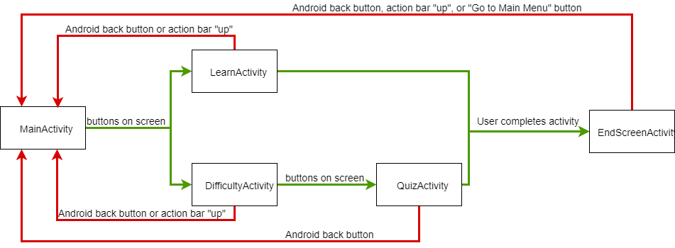
Navigation Between Activities

Slide 4
Main Activity (Mode Select)
This activity lists the 2 modes of our app (learning and quiz) and the three language options (Russian, Greek, and Armenian) for each mode
When a button is clicked, an intent is created to go to the correct activity (either DifficultyActivity for quiz buttons or LearnActivity for learn buttons) and stores language information in the intent
Displays the app name, and the various game modes.

Slide 5
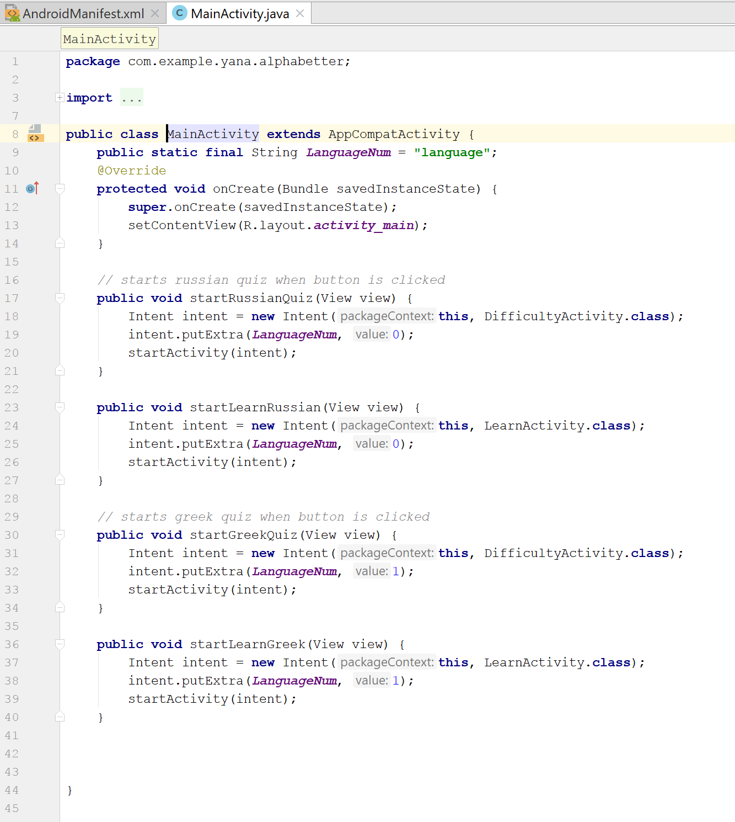
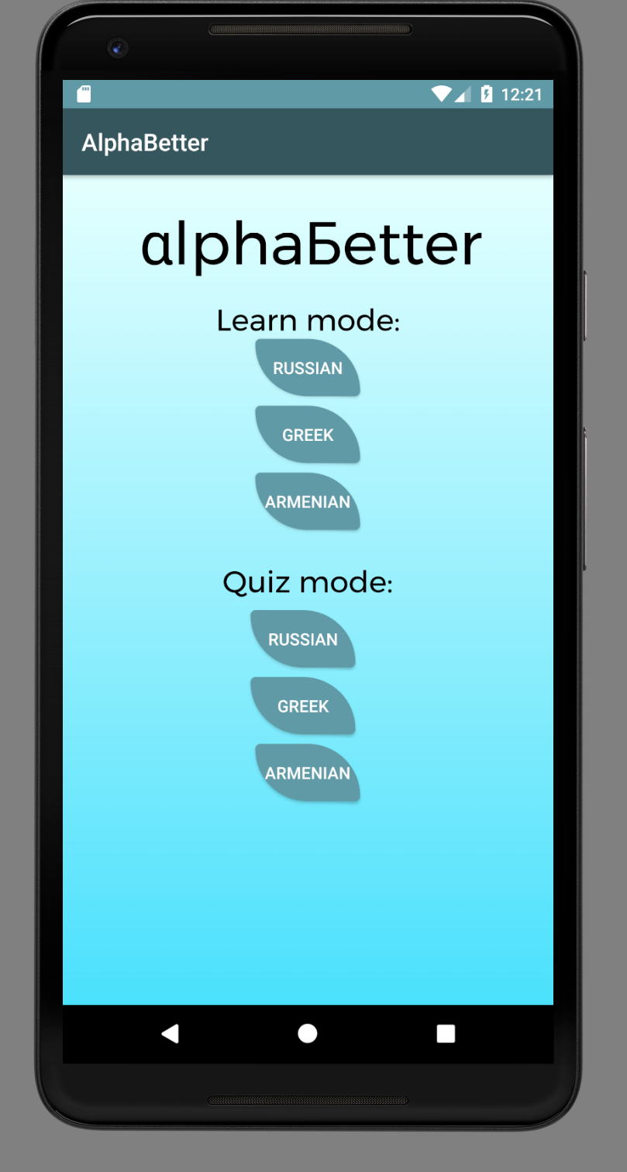
Main Activity Screen

Slide 6
Learn Activity
Allows the user to learn the alphabet, by listening to the pronunciation of the letter by a native speaker, and/or tracing the character, all at their own pace.
To play audio the MediaPlayer class is used to set a play onClick. The audio files are linked to their counterparts in the LetterMap.
Allows the users to trace the letters by with the custom LetterCanvas class

Slide 7
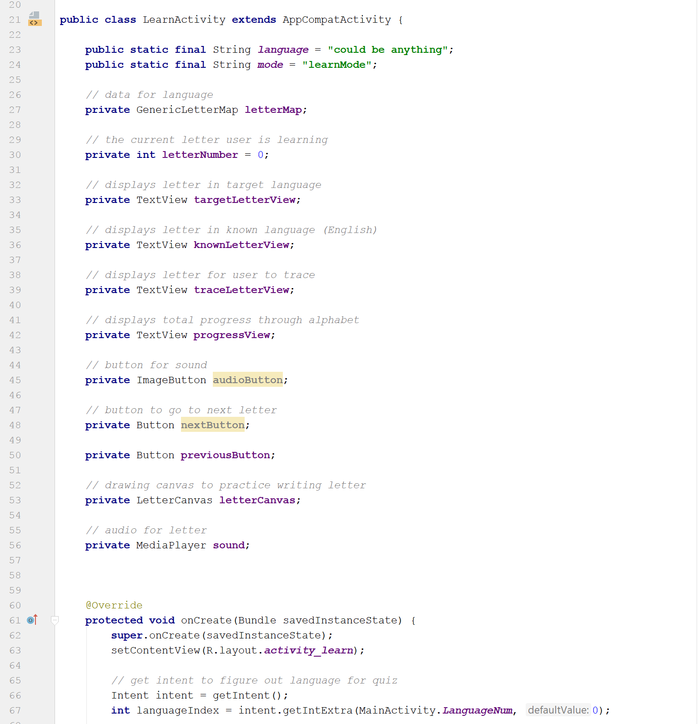
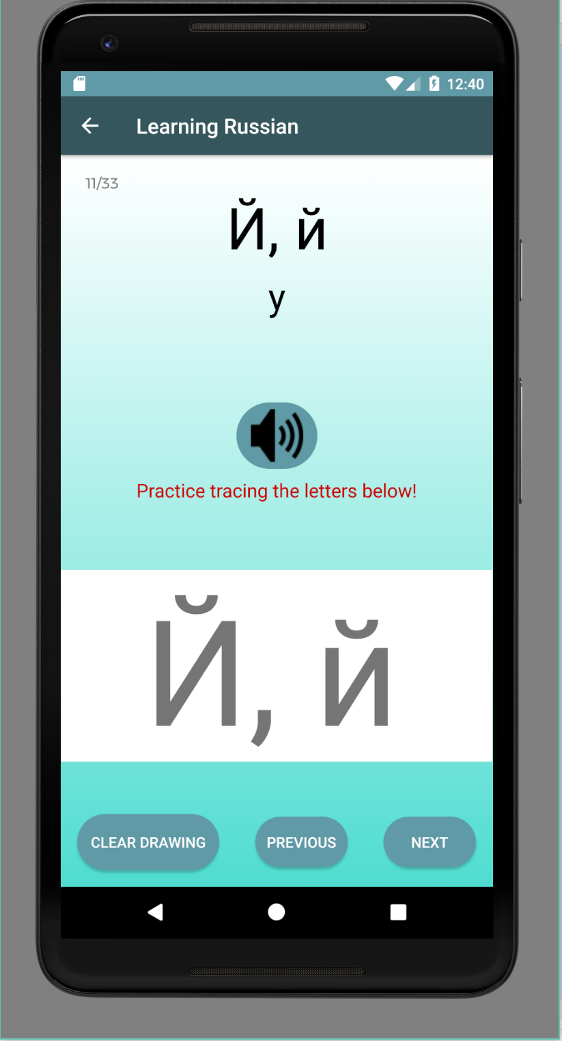
Learn Activity Screen

Slide 8
Difficulty Activity
Starts when user clicks one of the “quiz” buttons in MainActivity
Displays the two options for difficulty for QuizActivity
Allows the user to choose one of two modes to play the quiz mode in
Regular: 15 seconds per question with 3 lives
Hard: 10 seconds per question with 1 life
Amount of initial seconds per question decreases as quiz progresses
- Stores information for language/difficulty modes in intent for Quiz Activity
- Starts QuizActivity when user clicks one of the buttons

Slide 9
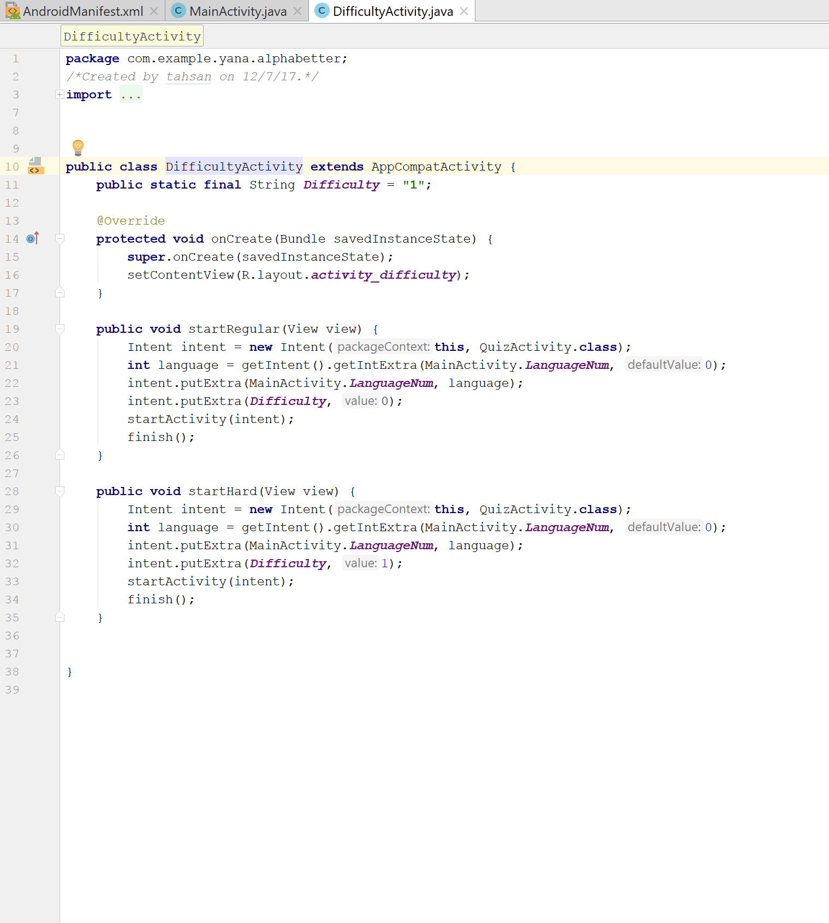
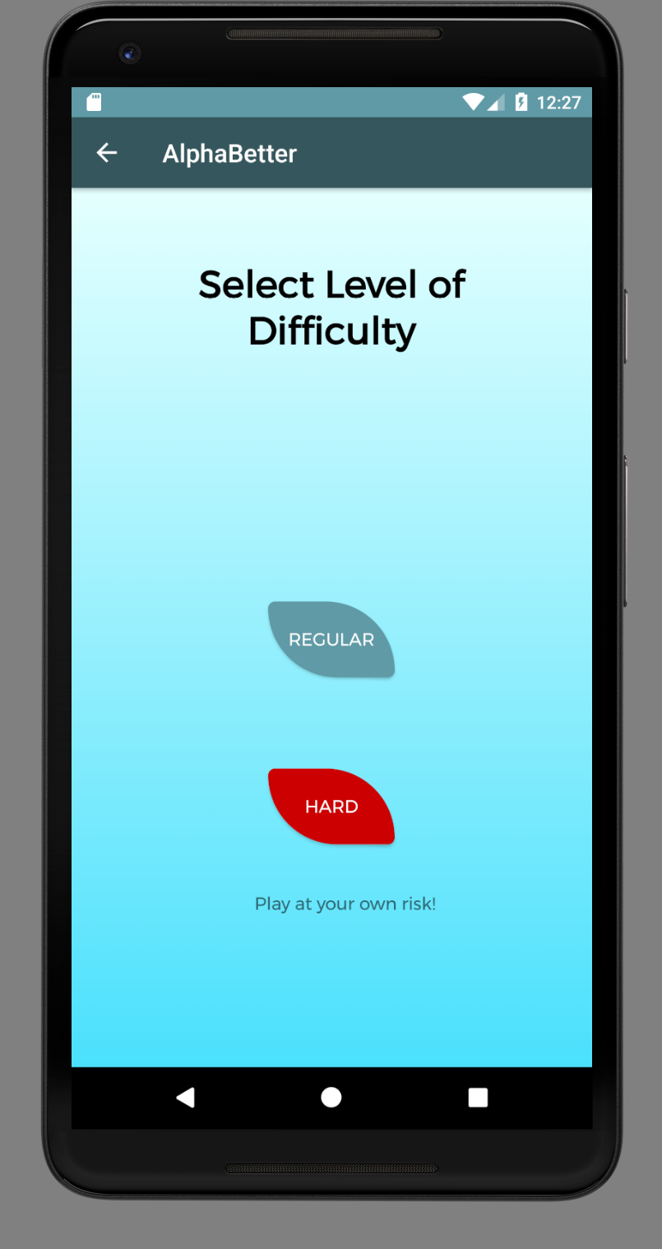
Difficult Activity Screen

Slide 10
Quiz Activity
The user selects a quiz in their choice of language and difficulty. The length of the quiz is determined by the length of the chosen alphabet, and questions take three forms:
The version of the letter in the target language (Russian, Greek, or Armenian) is displayed with the choices in Latin
Latin is displayed and the choices are in the target language
The pronunciation of the letter is played, and choices are in the target language
Quiz Activity first gets information from its intent to determine the language the user selected, then loads the appropriate letter map.

Slide 11
Quiz Activity cont...
The screens shows the score, various options, lives, and the remaining time.
If a user answers a question correctly, their score increases by 100*(TimeEnd/TimeStart)
If the user answers incorrectly, their lives decrease by one

Slide 12
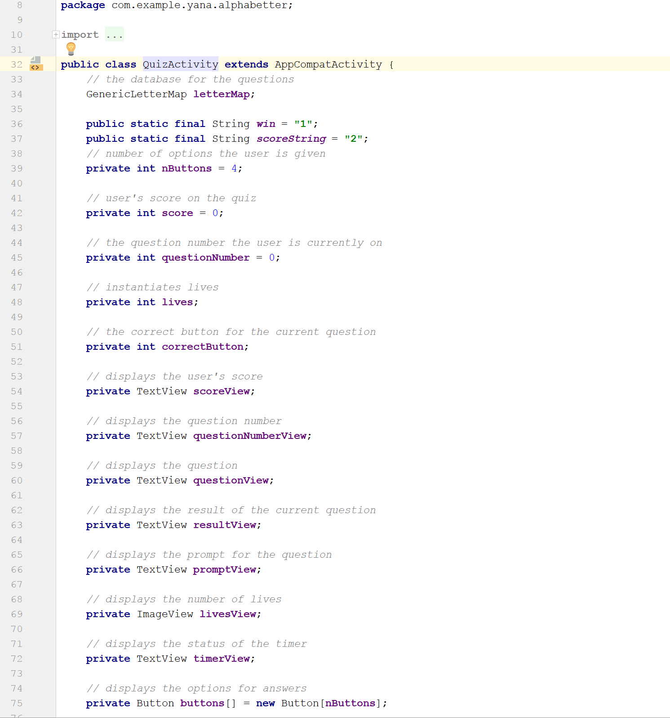
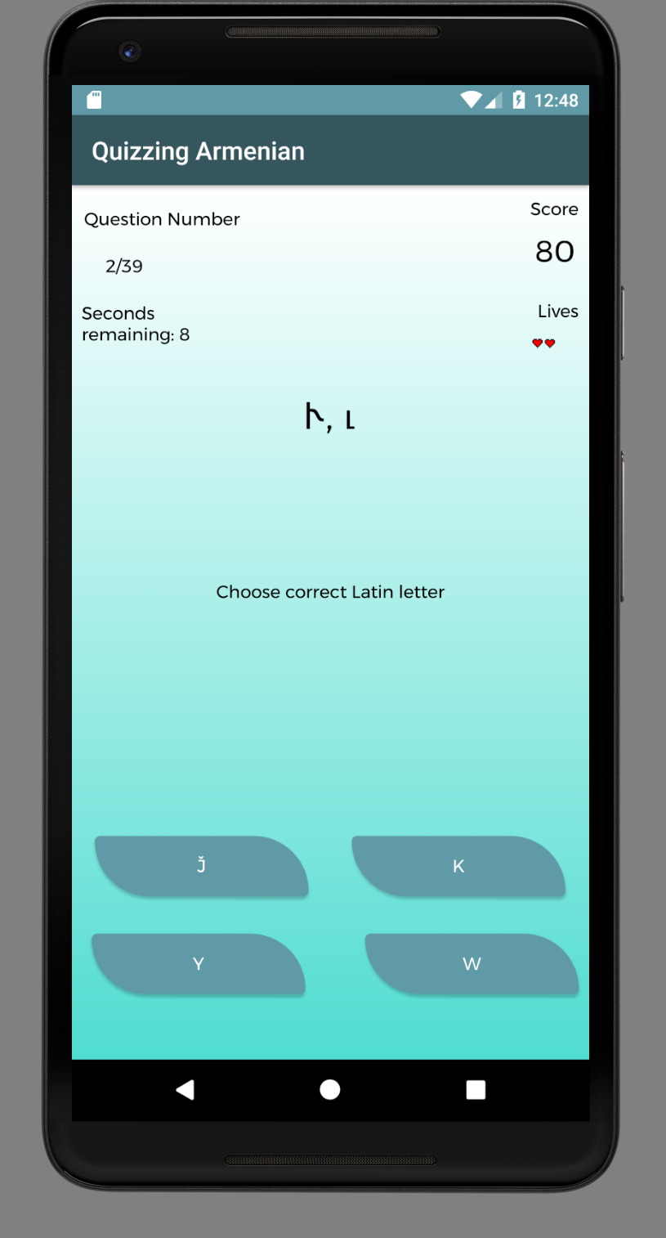
Quiz Activity Screen

Slide 13
End Screen Activity
Displays at the end of a Learn Activity or a Quiz.
Depending on the intents one of two screens will be shown. For a LearningAcvitity the user will be congratulated for learning a specific alphabet. However following a quiz, the user will be presented with their score, and a win or loss message.

Slide 14
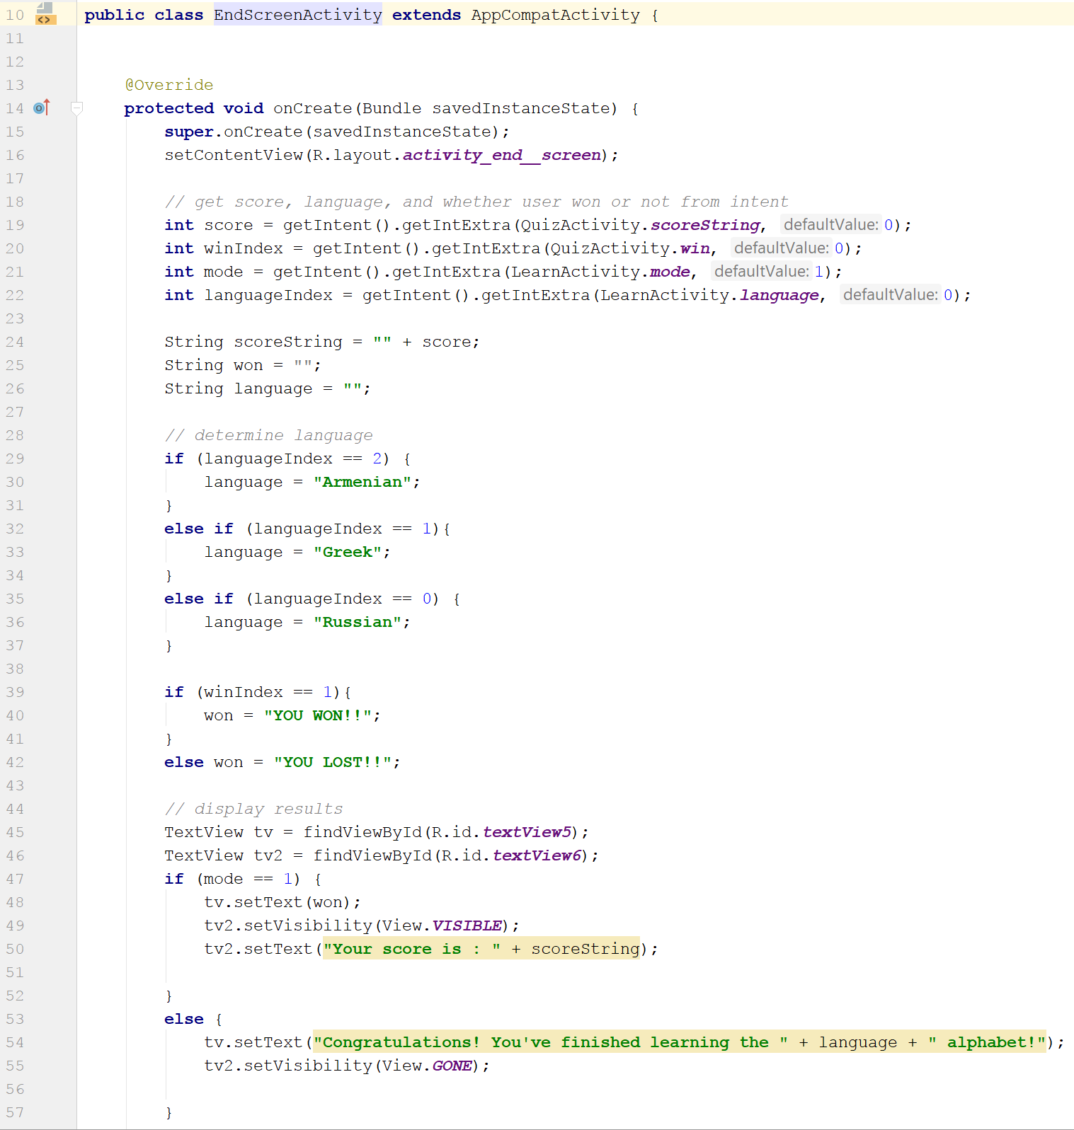
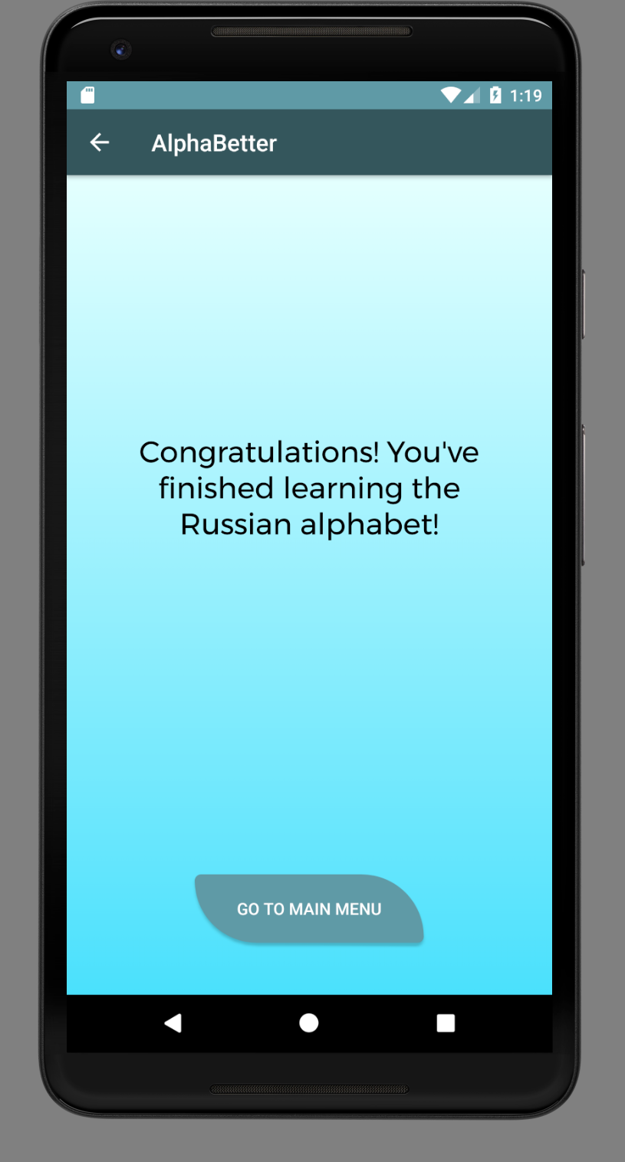
End Screen Activity Screen for
LearnActivity

Slide 15
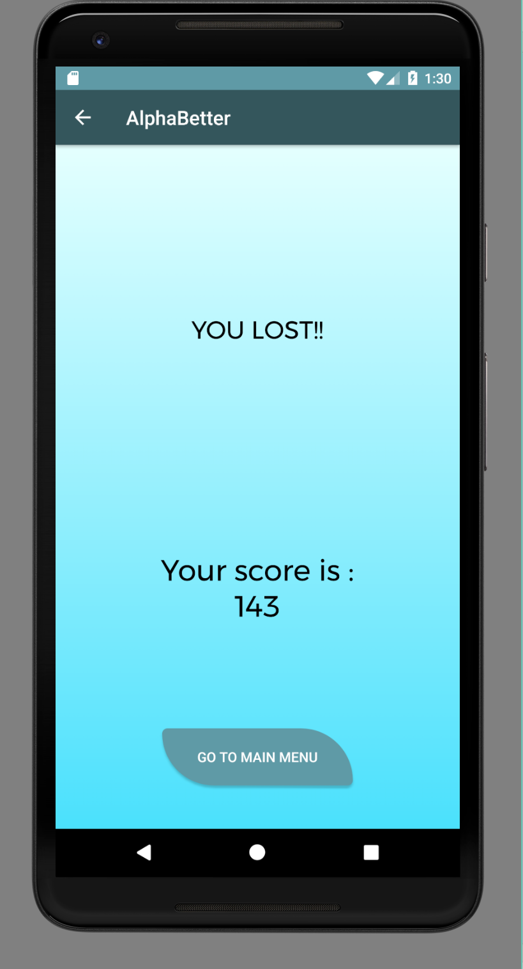
End Screen Activity Screen cont…
End screen for Quiz Mode

Slide 16
LetterMaps
Four classes: GenericLetterMap, and its three child classes RussianLetterMap, GreekLetterMap, and ArmenianLetterMap
Hold all of the language-specific data needed for LearnActivity and QuizActivity, including the alphabet in the target language, the latin transliteration of the alphabet, and the audio
GenericLetterMap is the framework to store , manage, and retrieve data, while its child classes “fill” in the data with the particular language data
GenericLetterMap allows for retrieval of any entry, and shuffling entries (used in QuizActivity)
Audio taken from open sources

Slide 17
LetterCanvas
Extends View class
Allows user to draw over letters in LearnActivity in red
Restricts drawing to a box in LearnActivity layout
Allows for user to clear the drawing to try again

